Slide 1
(TBD)
Market place
Project Definition
Team Members:
Emanuel Ben Hamo, Rotem Carmon, Vova Eygel

Slide 2
Highlights
Product Name: TBD
Product Short Description:
A marketplace for social media influencers and advertising campaigns.
Users:
Guest users, influencers, brand managers, Admin.
Key features:
Offer advertising campaigns by brands, chat between influencers and campaign managers,
Show influencers reviews & description.
Guest mode:
A guest can browse all current advertising campaigns offered by brands and look at specific influencer details, information & reviews.

Slide 3
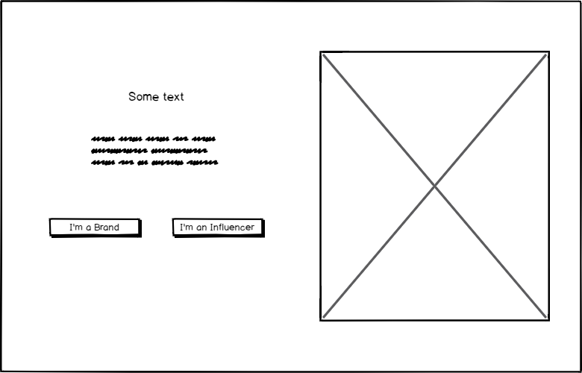
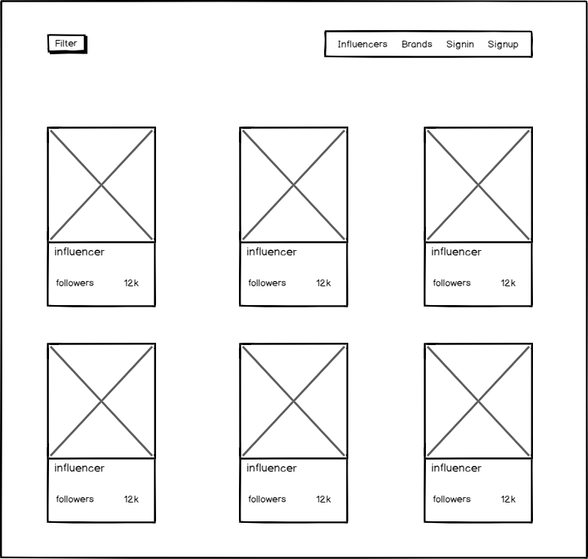
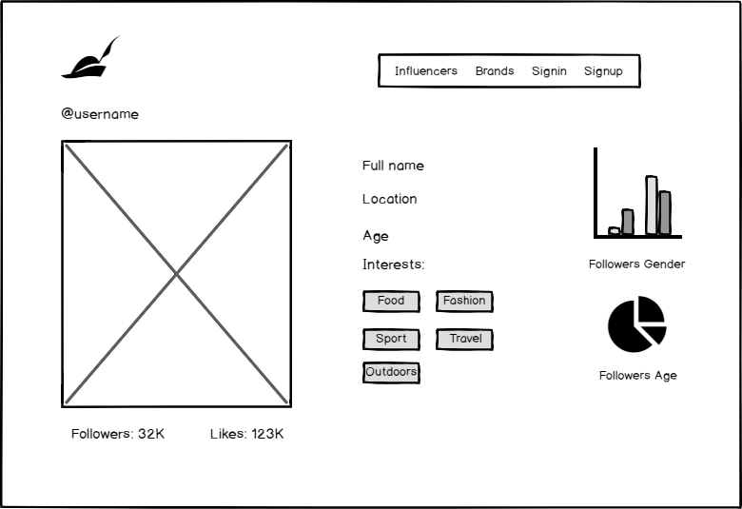
Main Pages
Home page
A short preview of the services available for social media influencers and advertising campaign managers.
Influencer list
View all influencers.
Influencer details
View the details of a selected influencer.

Slide 4
Main Flows
Home page
Influencer details
Influencer list
On clicking the “I’m a brand” button the app will redirect to the influencers list.
After selecting an influencer from the list the app will redirect to the influencer’s details page.
*Clicking the “I’m an influencer” button the app will redirect to the campaigns list.

Slide 5
Home page

Slide 6
Influencers/campaigns list
Main Pages UX

Slide 7
Influencers details
Main Pages UX

Slide 8
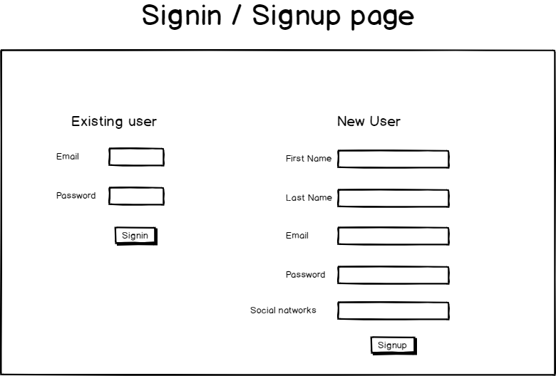
Main Pages UX

Slide 9
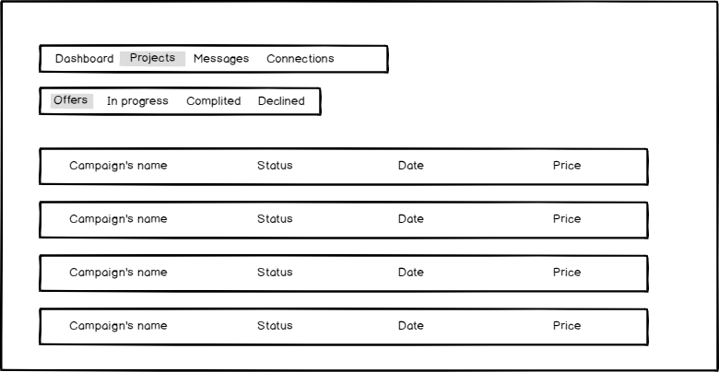
Back office

Slide 10
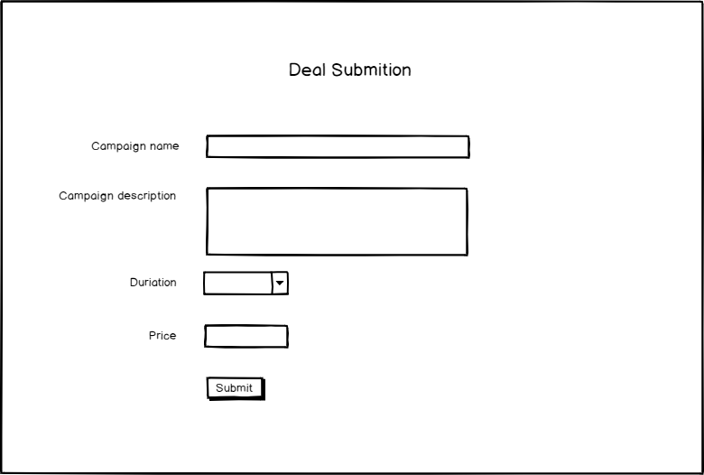
submit deal details form

Slide 12
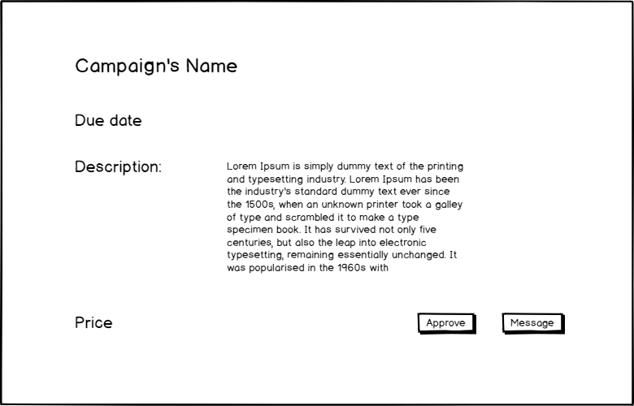
Campaign Details

Slide 13
Special Functionality for Demo
Guest mode auto

Slide 14
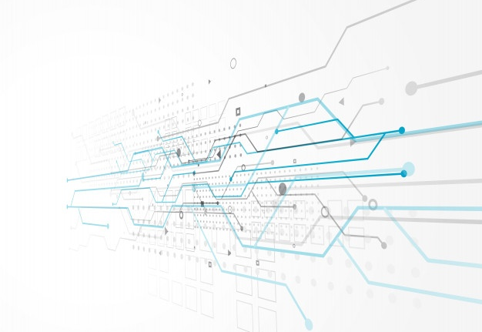
Technical Design

Slide 15

Data Model

Slide 16
Pages and Components

Slide 17
Store

Slide 18
sockets

Slide 19
Pages and Components

Slide 20
Ajax and REST API
CRUDL for stations with axios and Node.js
Authentication
User/password and server session
Storage
Cloudinary to store users profile and station images
Database
Mongodb on Atlas cloud databases
Web Sockets
Multi room with a Socket per station
Share
Share to Facebook (if time permits)

